Slide 1
Tutorial 8 – High Performance Computing, Command Line, and SLURM
This tutorial is created to facilitate the coding tutorial sessions of the Jumpstart Summer Program 2023 @ Data Sciences and Operations Department, USC Marshall.
If you have any questions, please contact yanfeizh@marshall.usc.edu.

Slide 2

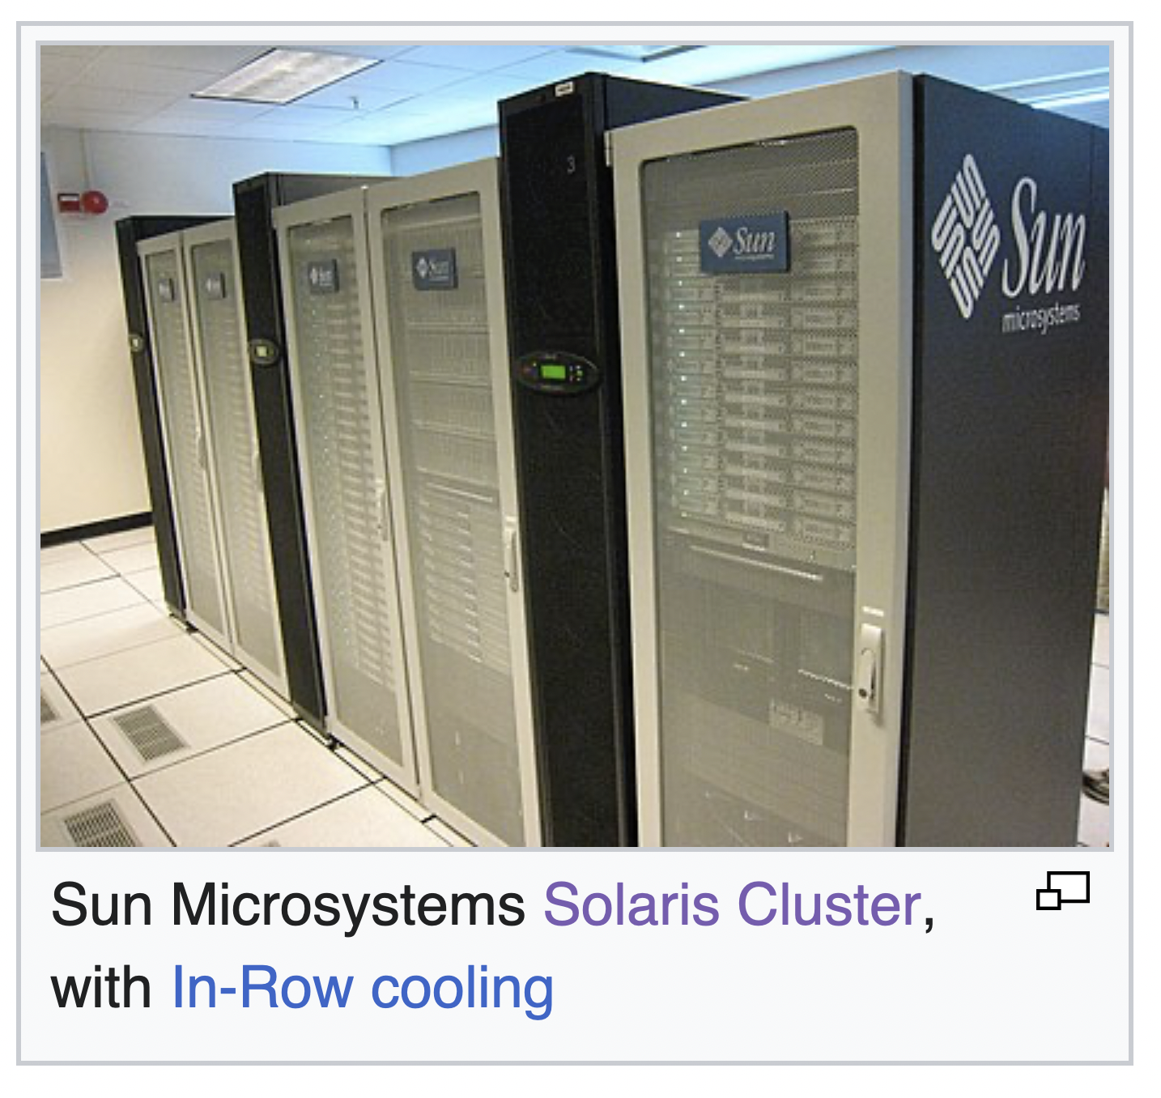
What is HPC and why it is needed
Computational research often requires resources that exceed those of a personal laptop or desktop computer.
High-performance computing (HPC) aggregates the resources from individual computers (known as nodes) into a cluster that works together to perform advanced, specialized computing jobs.
Pictures of computer cluster:

Slide 3
Advantages of HPC
HPC is becoming increasingly necessary for technological advancement. Some of the key advantages include:
Faster computational speed: it enables parallel processing, where different nodes can work on different parts of a larger problem simultaneously.
Scalability: clusters can easily be scaled by adding more nodes to the cluster as the workload increases or the data size grows..
Resource Sharing: clusters facilitate resource sharing, allowing multiple users or applications to access the computing resources efficiently.
Easy Management: Modern cluster management tools and software make it easier to configure, deploy, and manage clusters effectively.
Support for Big Data: Clusters are well-suited for handling large datasets and big data analytics. They enable distributed storage and processing.
…

Slide 4
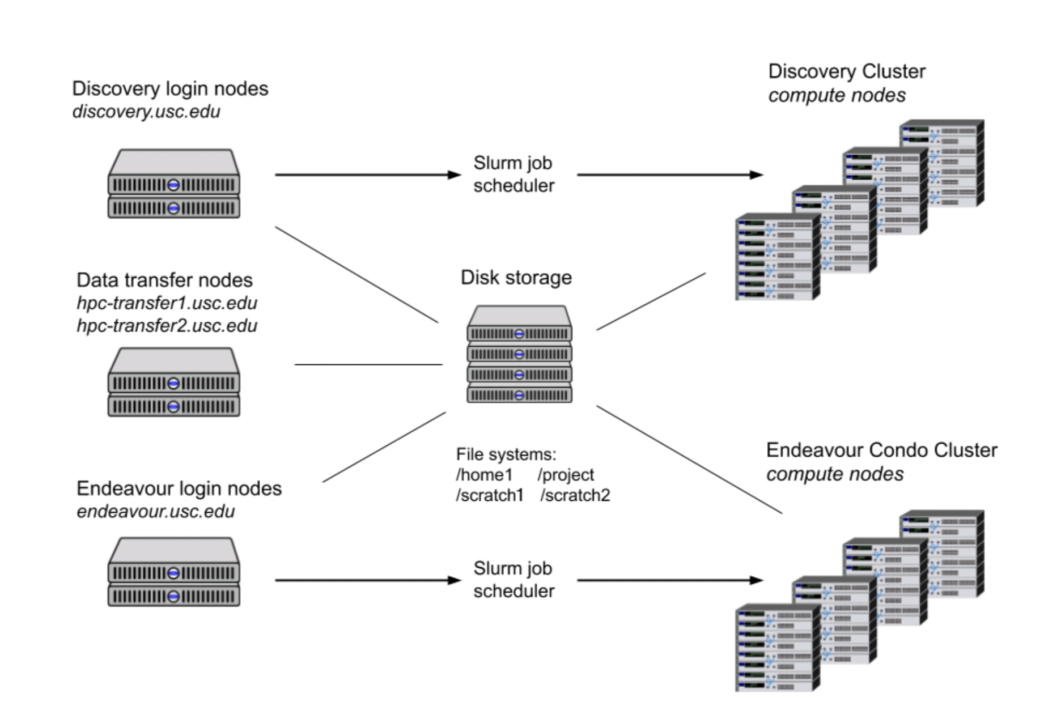
Performing HPC with CARC
USC’s Center for Advanced Research Computing (CARC) provides advanced computational research support, including High-Performance Computing, Cloud Computing, Secure Computing, Data Solutions, etc..

Slide 5
Workflow
The workflow for using Discovery typically consists of the following steps:
Connecting to the USC network or VPN
Logging in to the login node
Organizing and Transferring files
Installing and running software, establishing virtual environments
Testing your job interactively on a compute node
Submitting your job to the job scheduler to run it remotely on a compute node
Monitoring your job and collecting the results when it has completed

Slide 6
Workflow
Connecting to the USC network or VPN
Discovery requires users to connect to the USC Secure network while on campus. For off-campus users, a connection to a USC VPN needs to be set up before accessing CARC systems. (e.g., using Cisco-AnyConnect)
2. Logging in to the login node
To log in to the Discovery login node (also known as the head node), you will need to use a secure shell (ssh). You will need your USC NetID to SSH into the login node.
On Mac - Open Terminal from natively installed applications or IDEs (e.g. VS Code)
On Windows - Download and install third-party SSH client such as PuTTY, and MobaXterm.
In Terminal, enter ssh <username>@discovery.usc.edu. The username is your personal USC NetID. Next enter the USC NetID password and complete the DUO Authentication.
(demo)

Slide 7
Workflow
3. Organizing and Transferring files
Managing files:
All CARC account holders are assigned four directories on four file systems where they can store files and run programs: home1, project, scratch, and scratch2
home1 /home1/<username> | 100 GB | Store personal files and configurations
Project /project/<PI_username>_<id> | 5TB | store and share files among a research group. Every project has its own directory
scratch, scratch2 /scratch/<username> | 10TB | Store temporary files, only accessible by owner

Slide 8
Workflow
3. Organizing and Transferring files
Transferring files:
Between local machine and discovery - using commands sftp, scp, or rsync as well as GUI apps like Cyberduck or FileZilla. For example:
Sending local to remote:
scp /local_path_send_from <username>@discovery.usc.edu:/remote_path_save_to
Downloading remote to local:
scp <username>@discovery.usc.edu:/remote_path_save_to /local_path_send_from
Between internet and discovery - using commands like wget, curl, or aria2c or, for Git repositories, the different git commands.

Slide 9
Workflow
3. Organizing and Transferring files
Creating or editing files:
Can either create and edit files from local machine and transfer it to discovery or edit the files on the server directly. For the later, one can use text-editors such as micro, nano, vim, or emacs. (vim cheat sheet https://vim.rtorr.com).

Slide 10
Workflow
4. Installing and running software, establishing virtual environment
On Discovery, the CARC maintains software, compilers, and libraries using the module system. To see available software, enter module avail, to load software, enter module load <software_name>
Managing virtual environment:
One can use conda to manage packages and environments.
Common commands: Create a new environment with Python3.7: conda create -n <env_name> python = 3.7 Install packages in this environment: first activate it: conda activate <env_name>, then put conda install <package_name> = <package_version> Check the existing environments: conda env list Delete an environment: conda env remove -n <env_name>
(demo)

Slide 11
Jobs and job schedulers
Before going to the next step, let’s explain how the jobs run on discovery.
A job (batch or interactive) consists of all the data, commands, scripts, and programs that will be used to obtain results.
Because the Discovery computing cluster is a shared system, we use a job scheduler called ‘Slurm’ (Simple Linux Utility for Resource Management), which performs the following functions:
Schedules user-submitted jobs
Allocates user-requested compute resources
Processes user-submitted jobs
Common Slurm commands:
salloc: allocate resources for an interactive job in real time (usually for debugging and testing).
sbatch: submit a job script for later execution.
scancel: cancel a pending or running job.
sinfo: reports the state of computing resources.
squeue: the state of jobs.

Slide 12
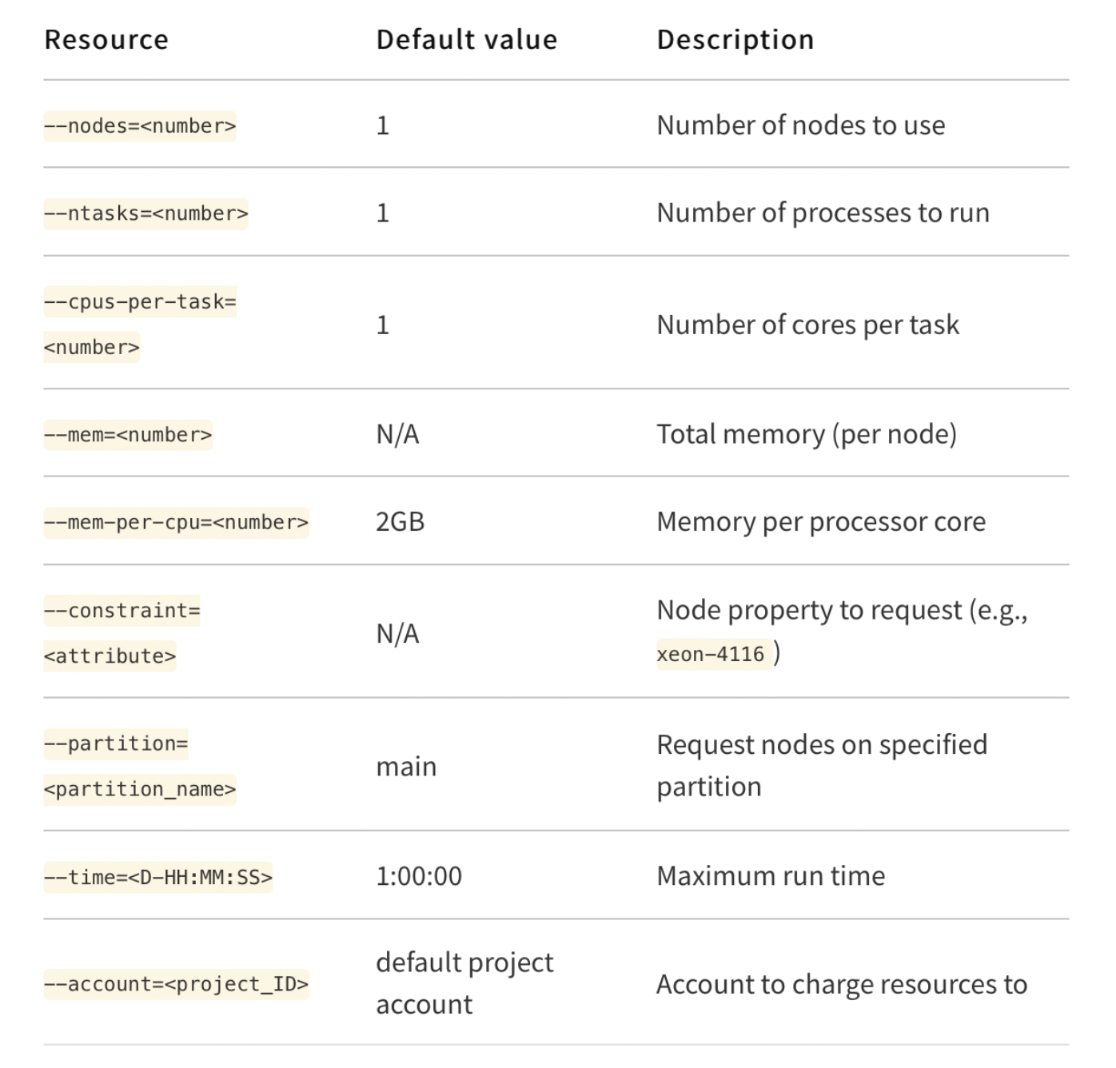
Requesting resources
Discovery has over 470 nodes and a few partitions available. The general resources overview and description of intended purpose of each partition can be found here - https://www.carc.usc.edu/user-information/user-guides/hpc-basics/discovery-resources.
One can specify various parameters when requesting resources. The following table from USC CARC website summarizes the common types and their associated commands:

Slide 13
Workflow
Testing your job interactively on a compute node
After finishing writing or editing a script for research experiments, it is always recommended to first perform some basic tests of your job interactively on a compute node before submitting it as a batch job to the Slurm job scheduler, ensuring that you will have quality results after the job completes.
This can be done by requesting an interactive session with a compute node using the salloc command.
For example, to request 1 CPU and 2 GB of memory for one hour, enter:
salloc --time=1:00:00 –mem=2GB --account=<project_id>
After running the command, the job scheduler will add your interactive job to the job queue. Once your job starts, you can then test by loading the software environment and running scripts or programs. Once you are confident that your job will run correctly, you are ready to submit a batch job through Slurm.

Slide 14
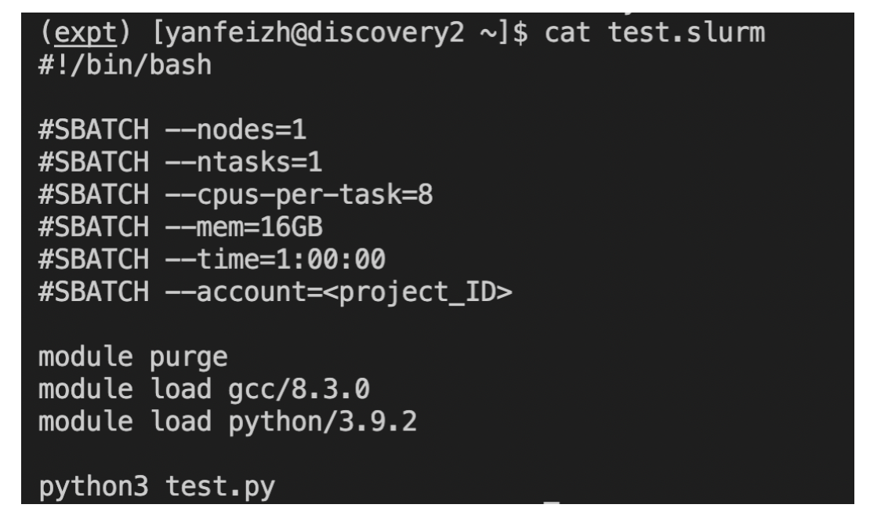
Workflow
6. Submitting your job to the job scheduler to run it remotely
After you have tested your job interactively and achieved the results you want, you can now submit your batch job to Slurm.
To submit a job, first create a Slurm job script. By convention, we can write this procedure in a bash file as a set of actions to perform.
In the example below we first created a file named ’test.slurm’. In this file the first line specifies which shell interpreter to use when running the script (here uses bash). The next set of lines starting with #SBATCH uses Slurm options to specify the requested resources for your job. Then we loads the required software module by a set of module commands. (Following this we can optionally activate any virtual environment). In the last line, we run the python script.
After making this file, we can simply submit the whole thing within one line - sbatch test.slurm

Slide 15
Workflow
7. Monitoring your job and collecting the results when it has completed
To check the current submitted jobs for a specific user, run squeue -u <username>. To cancel a job, run scancel <jobID>. To check the details for a specific job, run scontrol show <jobID> -dd <jobID>. The output is usually printed in a file named ’slurm-jobid.out’, we can look at the current result by cat slurm-jobid.out. Or, if we have real-time printed results available, we can run watch -n 0.5 "cat slurm-jobid.out" to check the result every 5 seconds.

Slide 16

Template
At the end, here is a template for submitting a job on discovery using Slurm:
Prepare the script test.py
Test the script by running an interactive job
Create a bash file including the actions of submitting batch jobs
Submit a batch job with sbatch test.slurm
Check job status with squeue -u username or watch slurm-jobid.out
salloc --ntasks=1 --mem-per-cpu=2gb --time=01:00:00 --partition=debug --cpus-per-task=16
python3 test.py
#!/bin/bash #SBATCH --ntasks=1
#SBATCH --cpus-per-task=1
#SBATCH --time=0:05:00
module load python conda activate env_name1
python3 test.py —

Slide 17

References & Recommended reading
USC CARC website - https://www.carc.usc.edu/user-information/user-guides/hpc-basics/getting-started-discovery
Slurm official documentation - https://slurm.schedmd.com/quickstart.html
Linux command cheatsheet - https://phoenixnap.com/kb/wp-content/uploads/2021/11/linux-commands-cheat-pdf
Git cheat sheet - https://www.git-tower.com/blog/git-cheat-sheet
Vim cheat sheet - https://vim.rtorr.com

